Slide 1
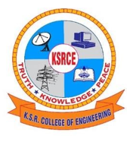

FACIAL MOVEMENT BASED ROBOTIC ARM CONTROL USING ARDUINO AND PYTHON
K.S.R. COLLEGE OF ENGINEERING (Autonomous) ELECTRICAL AND ELECTRONICS ENGINEERING
PRESENTED BY:
PROJECT SUPERVISOR:
DR. S. RAMESH M.E., Ph.D.,
Professor and Head
MOHAMMED AL FAHAD | (1914026)
PREM PRAKASH S | (1914035)
KAVINRAJ V | (1914507)
DEEPA V | (1914701)

Slide 2
CONTENTS
Abstract
Introduction
Objective
Literature Survey
Existing System
Proposed System for Facial Movement Based Robotic Arm Control
Conclusion and Future Scope
References
List of Publications

Slide 3
ABSTRACT
Physically disabled people are an important part of the society who has not yet received the same opportunities of inclusion as others in the Society
Therefore, it is necessary to develop easily accessible systems to achieve their inclusion within the new technologies
In this project an assistive multimodal system is presented that enables physically disabled individuals to control the robotic arm movement with the help of facial movements

Slide 4
INTRODUCTION
Robotic arm is a programmable manipulator, that comprises of linear and rotary joints to allow for controlled movements
Nowadays Robotic arm is widely used in various fields such as industries such as medical and even military due to its abilities of high accuracy, efficiency, and repeatability
While this is not a problem for a healthy individual, this may be an insurmountable bound for people with limited freedom of movement of their limbs

Slide 5
OBJECTIVE
To present an assistive multimodal robotic arm control system that is aimed for the disabled people such as quadriplegic or people with severe speech and motor impairment
To enable physically disabled individuals to control the robotic arm movement with the use of facial and eye movements

Slide 6
LITERATURE SURVEY
AUTHOR | PROPOSED SYSTEM | LIMITATIONS
V K Sharma et al. (2021) | Gaze Controlled Robotic Arm for Persons with SSMI | Only provide 4 degrees of freedom of movement and used JavaScript
Margret et al. (2018) | Hand Gesture Controlled Robotic Arm for Nonverbal People | Could not be used by disable people such as quadriplegic
Eric Sung et al. (2017) | Eye tracking using Hough transform | Used complex algorithm so processing time and latency was too high

Slide 7
EXISTING SYSTEM
The existing system has drawbacks such as using costly external hardware such as lasers and IR sensors for tracking
It also has only 4 degrees of freedom for the movement of the robotic arm and complex software requirements that were not user friendly

Slide 8
DRAWBACKS OF EXSISTING SYSTEM
Mounting devices: These systems needed a mounted device like lasers or cameras on the user which became tedious
Biometric identification: The system used biometric identification for which the users had to register themselves before using the system. It wasn’t open for all which has been rectified by the proposed application
Complex algorithms: The previous systems used many complex algorithms that needed a lot of calculations to be done depending on various markers

Slide 9
PROPOSED SYSTEM FOR FACIAL MOVEMENT BASED ROBOTIC ARM CONTROL
Currently, the existing systems use a mounted device like lasers on the user and use slow and complex algorithms to track facial movements
So, to overcome such issues our proposed system is an universal software with plug and play technology for facial movement tracking and controlling the robotic arm using the data

Slide 10
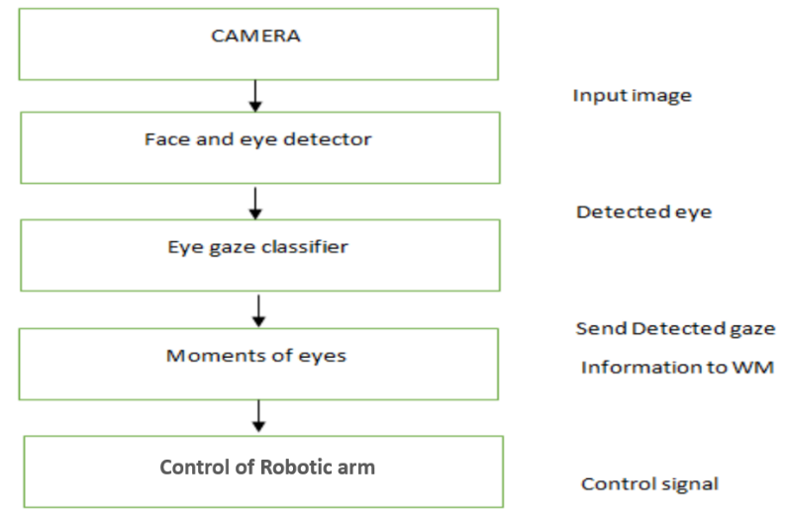
BLOCK DIAGRAM

Slide 11
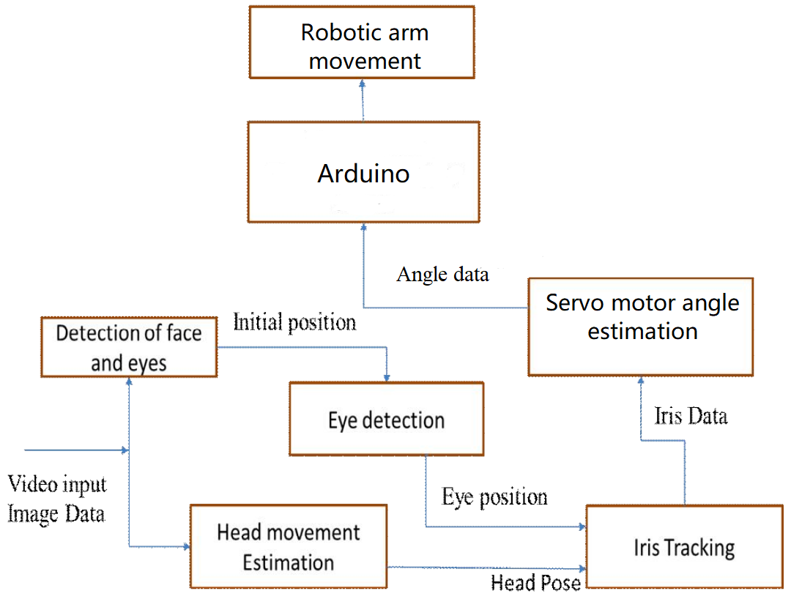
PROPOSED SYSTEM ARCHITECTURE

Slide 12
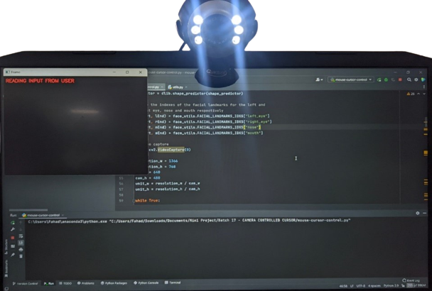
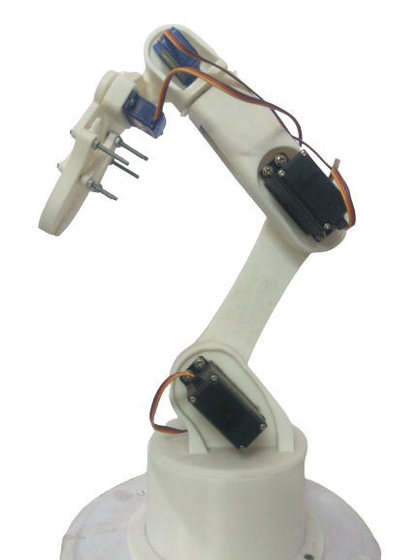
HARDWARE SETUP
Figure 1 Reading the input from user
Figure 2 Robotic arm

Slide 13
PROPOSED SYSTEM OPERATION
The proposed system uses a camera with 20 megapixels to capture the image of the users face and eyes at 30 frames per second
With the help of the dlib program, facial landmarks or points are placed over the face in the captured image to aid the facial tracking component.
This data is processed by Python and the facial movement data is converted into servo motor angles and this data is fed into the pyfimata program to transfer the data to the Arduino
This data is used to control the servo motor which moves the robotic arm as per the users desire and movement.

Slide 14
PROPOSED SYSTEM OPERATION
The proposed system can be divided into two components:
Face detection component
Robotic arm movement mapping component

Slide 15
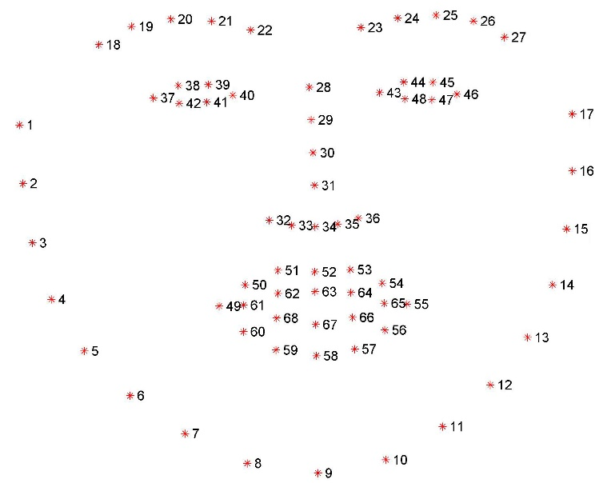
FACIAL LANDMARK PLACEMENT
The Dlib facial landmark detector marks the face into 68 points as shown in figure below. These points will be used to measure the Eye Aspect Ratio and Mouth Aspect Ratio

Slide 16
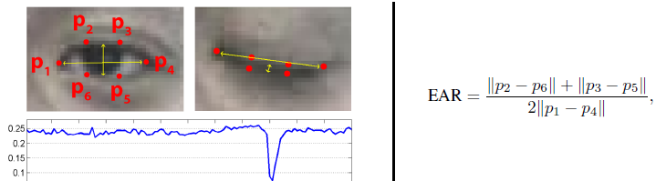
EYE ASPECT RATIO
It is the measure used in facial recognition and computer vision to detect eye blinks and track eye movements. It is calculated as the ratio of the distance between the vertical landmarks of the eye to the distance between the horizontal landmarks of the eye

Slide 17
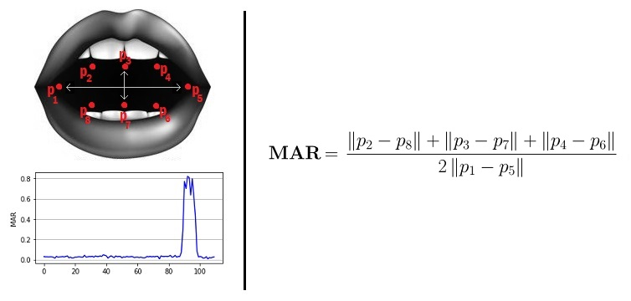
MOUTH ASPECT RATIO
It is used to detect whether a person is opening their mouth or not. This is a similar mathematical approach as that of EAR as places points on the user’s mouth and also measures the ratio of the length of the mouth to the width of the mouth

Slide 18
ROBOTIC ARM MOVEMENT MAPPING
The facial movement data, eye aspect ratio and mouth aspect ratio is converted into servo motor angles.
The servo motor angle Data is sent to the pyfirmata so that it can be used to transfer the data to the arduino
Based the inputs the arduino controls the servo motor the manipulate the robotic arm

Slide 19
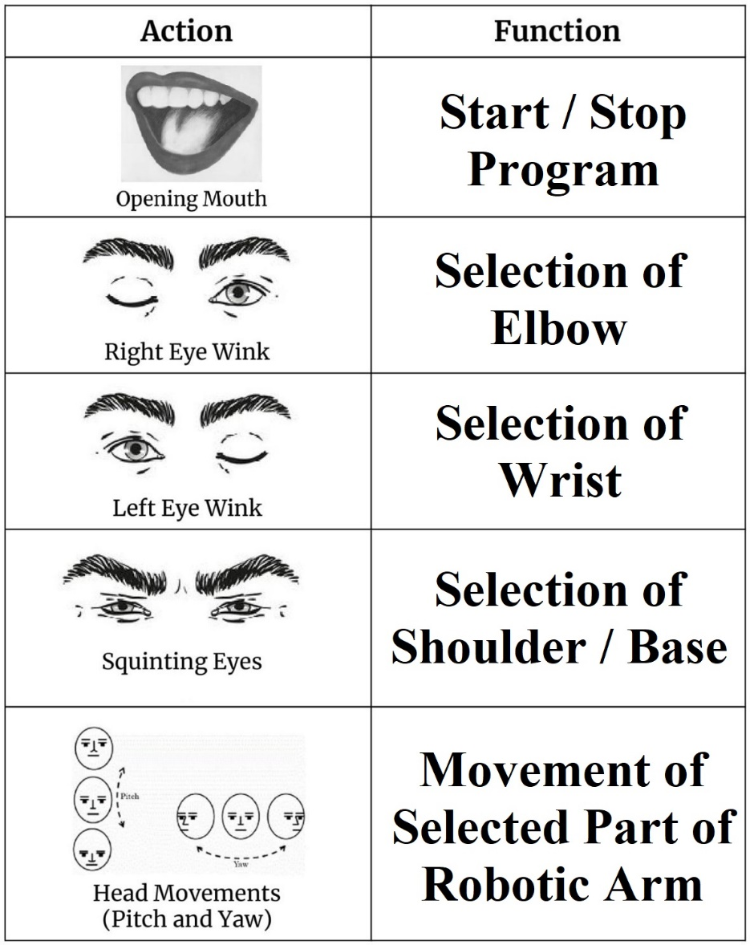
FACIAL MOVEMENTS AND IT’S FUNCTION

Slide 20
APPICATIONS OF PROPOSED SYSTEM
Used by disabled people for getting more job opportunities
In automotive industry it is used for assembly of various parts
It is used in the medical field to perform non – invasive surgeries and laboratory work

Slide 21
CONCLUSION
With the use of a camera and python technology, the system architecture is prepared. User is able to view head and eye movements through the camera display, the user is able to select a part of the robotic arm and move it as needed and perform various actions without any calibration
This application benefit disabled individuals who wants to achieve greater mobility or use it in the same way as ordinary people
The Goal and soul purpose of making this project is to simplify the use of the robotic arm with only one software and also make it cost effective so it will be used by people with severe disabilities

Slide 22
FUTURE SCOPE
Since the type of gripper used is limited to jaw type gripper, It may be vastly improved by providing a modular gripper system that enables the user to select any type of gripper that is necessary for a specific application
Improvement in the system’s accuracy and precision will help in use various high precision tasks in industries such as fabric painting, welding and non – invasive surgeries

Slide 23
REFERENCES
[1] V. Krishna Sharma, K. Saluja, V. Mollyn and P. Biswas (2021), "Eye gaze controlled robotic arm for persons with severe speech and motor impairment", ACM Symposium on Eye Tracking Research and Applications ser. ETRA'20 Full Papers, 2021. (pp 113 – 119)
[2]. Jeevithashree, D. V., Saluja, K. S., Biswas, P. (2019). A case study of developing gaze controlled interface for users with severe speech and motor impairment. Technology and Disability, (pp 63-76).
[3]. Rosebrock A. (2019), Facial landmarks with dlib, OpenCV, and Python, Available at https://www.pyimagesearch.com/2017/04/03/facial- landmarks-dlib-opencv-python/
[4]. Baltrusaitis, T., Zadeh, A., Lim, Y. C., Morency, L. P. (2018). Facial behavior analysis. In 2018 13th IEEE International Conference on Automatic Face andGesture Recognition (FG 2018) (pp. 59-66). IEEE.
[5]. Biswas P. and Jeevithashree DV (2018), Eye Gaze Controlled MFD for Military Aviation, ACM International Conference on Intelligent User Interfaces (IUI) 2018 (pp 165 – 170)

Slide 24
REFERENCES
[6]. Koch, P. J., van Amstel, M. K., Dębska, P., Thormann, M. A., Tetzlaff, A. J., Bøgh, S., Chrysostomou, D. (2017). A skill-based robot co-worker for industrial maintenance tasks. Procedia Manufacturing, 11, (pp 83-90).
[7]. Alsharif S., Kuzmicheva O. and Gräser A. (2016), Gaze Gesture-Based Human Robot Interface, Zweite transdisziplinäre Konferenz,Technische Unterstützungssysteme, die Menschen wirklich wollen, 2016 (pp 34–40)
[8]. Bremner, P., Celiktutan, O., Gunes, H. (2016). Personality perception of robot avatar teleoperators. In 2016 11th ACM/IEEE International Conference on Human-Robot Interaction (HRI) (pp. 141-148). IEEE
[9]. Dziemian, Sabine, William W. Abbott, and A. Aldo Faisal (2016), Gaze-based teleprosthetic enables intuitive continuous control of complex robot arm use: Writing &amp; drawing. 2016 6th IEEE International Conference on Biomedical Robotics and Biomechatronics (BioRob). (pp 102 – 107).
[10]. Khonglah, J. R., &amp; Khosla, A. (2015). A low cost webcam based eye tracker for communicating through the eyes of young children with ASD. In Next Generation Computing Technologies (NGCT), 2015 1st IEEE International Conference (pp 925-928)

Slide 25
REFERENCES
[11]. Hansen, J. P., Alapetite, A., MacKenzie, I. S., Møllenbach, E. (2014). The use of gaze to control drones. In Proceedings of the Symposium on Eye Tracking Research and Applications (pp. 27-34)
[12]. Dostal, J., Kristensson, P. O., Quigley, A. (2013). Subtle gaze-dependent techniques for visualising display changes in multi-display environments. In Proceedings of the 2013 international conference on Intelligent user interfaces (pp. 137-148).
[13]. Bannat, A., Gast, J., Rehrl, T., Rösel, W., Rigoll, G., Wallhoff, F. (2011). A multimodal human-robot-interaction scenario: Working together with an industrial robot. In International Conference on Human-Computer Interaction (pp. 303-311). Springer, Berlin, Heidelberg.
[14]. San Agustin, J., Skovsgaard, H., Mollenbach, E., Barret, M., Tall, M., Hansen, D. W., Hansen, J. P. (2010). Evaluation of a low-cost open- source gaze tracker. In Proceedings of the 2010 Symposium on Eye-Tracking Research (pp 77-80).
[15]. Betke, Margrit, James Gips, and Peter Fleming (2009) &quot;The camera mouse: visual tracking of body features to provide computer access for people with severe disabilities.&quot; IEEE Transactions on neural systems and Rehabilitation Engineering 10.1: (pp 1-10).

Slide 26
REFERENCES
[16]. Bonneau, E., Taha, F., Gravez, P., Lamy, S. (2009). Surgicobot: Surgical gesture assistance cobot for maxillo-facial interventions. In Perspective in Image-Guided Surgery(pp. 353-360).
[17]. Chen Y. and Newman W. S. (2008), A Human-Robot Interface Based on Electrooculography, Proceedings of the IEEE Intl Conf on Robotics and Automation. (pp 212 – 216)
[18]. Dautenhahn, K., Woods, S., Kaouri, C., Walters, M. L., Koay, K. L., Werry, I. (2005). What is a robot companion-friend, assistant or butler?. In 2005 IEEE/RSJ international conference on intelligent robots and systems (pp. 1192-1197). IEEE.
[19]. Kim, D. H., Kim, J. H., Yoo, D. H., Lee, Y. J., Chung, M. J. (2001). A human-robot interface using eye-gaze tracking system for people with motor disabilities. Transaction on Control, Automation and Systems Engineering,(pp 229-235).
[20]. Fitts P.M. (2001), The Information Capacity of the Human Motor System In Controlling The Amplitude of Movement, Journal of Experimental Psychology 47 (1954): (pp 381-391).

Slide 27
LIST OF PUBLICATIONS
[1] Mohammed Al Fahad, Prem Prakash S, Kavinraj V, Deepa V has presented a paper titled "FACIAL MOVEMENT BASED ROBOTIC ARM CONTROL USING ARDUINO AND PYTHON” in the International Conference on Computing and Information Technology (ICCIT – 2023) organized by the Faculty of Computers and Information Technology, University of Tabuk, Saudi Arabia on March 28th 2023.
[2] Mohammed Al Fahad, Prem Prakash S, Kavinraj V, Deepa V has published a paper titled "FACIAL MOVEMENT BASED ROBOTIC ARM CONTROL USING ARDUINO AND PYTHON” in the International Journal on Innovative Research in Engineering (IJIRE), Volume no: 4, Issue no: 1, pp 151-154.

Slide 28
THANK YOU

